Slide 1


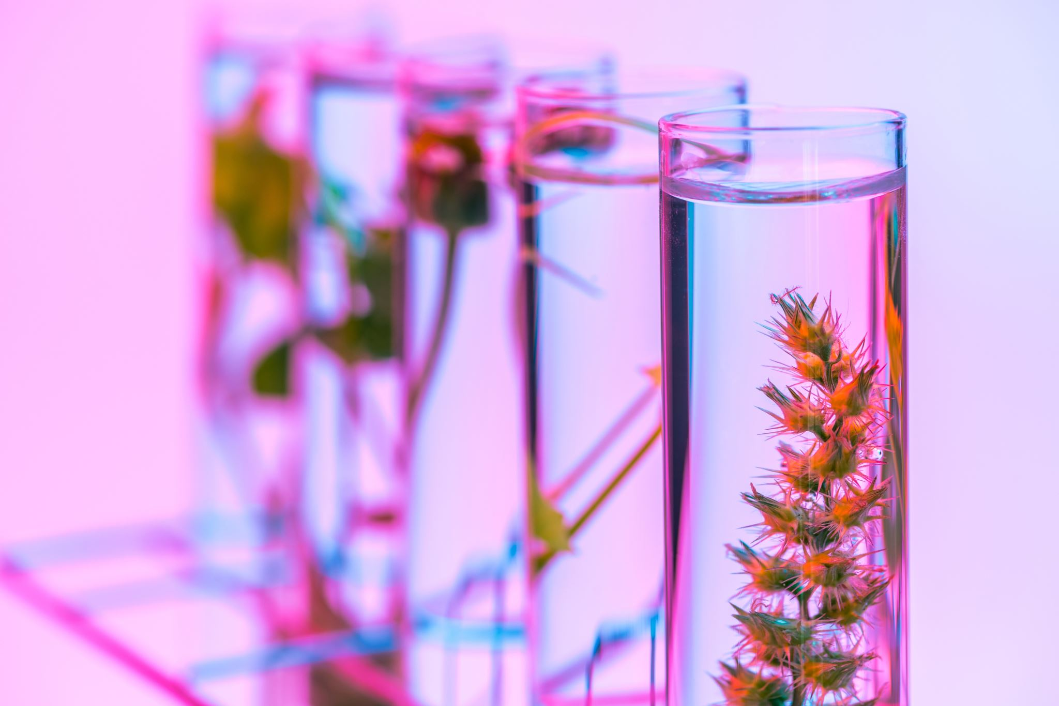
Deep Learning Powered Plant Disease Detection
By
Sowmith Kola
Neha Vunnam
Mourya Sashank Sure

Slide 2

Introduction
The agricultural industry, comprising more than 570 million farms globally, has historically relied on manual inspections. As an illustration, in a study conducted in 2010, it required a team of five specialists two weeks to inspect a 50-acre farm.
In India, where approximately 60% of its 1.3 billion inhabitants are engaged in agriculture, manual inspections can be time-consuming, leading to delays in essential crop management tasks.
Recent advancements in machine learning and image recognition have significantly enhanced accuracy rates. For example, a study conducted in 2020 demonstrated a 95% accuracy rate in the identification of grape leaf diseases through the use of AI.

Slide 3
Objective
The main goal of this research initiative is to develop a classifier capable of accurately assessing a plant's health status using image data.
State-of-the-art image recognition technology can rapidly categorize the health of crops. In a recent experiment, a system scanned a 10-acre field within just 3 hours, a task that would typically require several days for humans to complete.
Adoption of these AI systems resulted in significant benefits for farms in California, including a reported 10% increase in crop yield and a 15% reduction in pesticide usage in 2022.
Classifier should distinguish a leaf into one of 38 distinct categories. Examples of these categories include "Healthy Strawberry," "Late Blight Tomato," "Cedar Apple Rust Apple," and "Healthy Soybean."

Slide 4
Dataset
Dataset Size: Approximately 87,000 RGB images are included, offering a diverse range of healthy and diseased crop leaves.
Image Categories: The dataset encompasses 38 different classes representing various plant species and diseases.
Kaggle Source

Slide 5


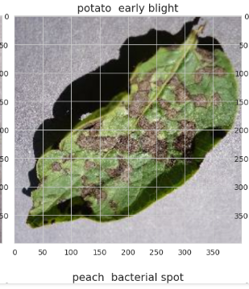
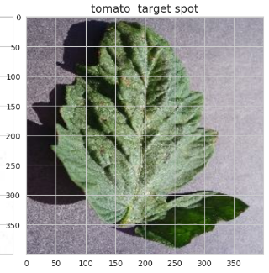
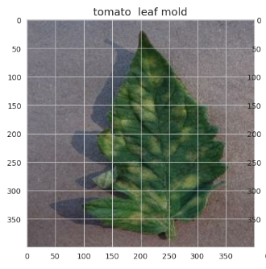
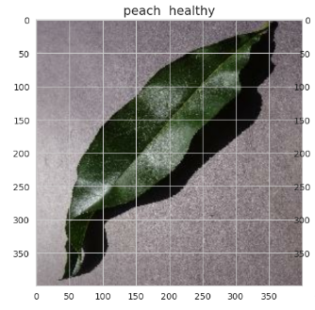
Dataset Images

Slide 6
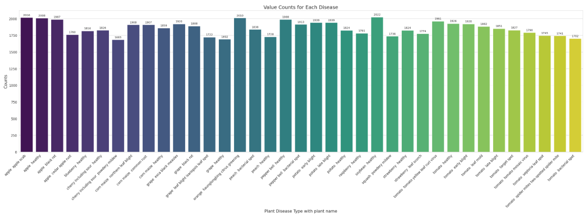
Bar Graph of different types of plant diseases

Slide 7
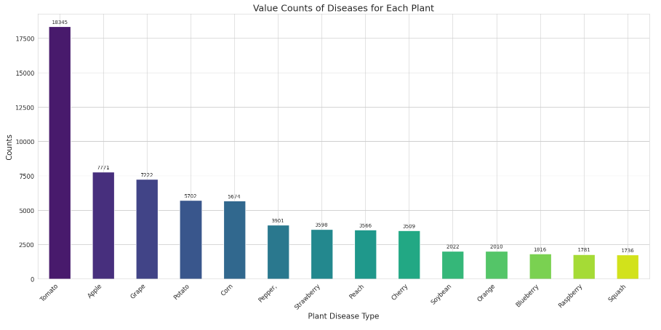
Diseases of Each Plant

Slide 8
Thank You

